Slide 1

Event Driven Architecture
A primer…
@ShawnWallace

Slide 2

The Great Debate…
http://martinfowler.com/articles/dont-start-monolith.html
Monolith First?
Micro services First?
http://martinfowler.com/bliki/MonolithFirst.html

Slide 3
Monolithic
Orders
Invoicing
Inventory
Logging
Warehouse
Profiles
Notes:
This is how a monolith is built

Slide 4
A problem with ‘Monolith First’
A product of our agile approach to our projects…smaller features finished earlier.
The goal is to deploy more often…this is hard.
One solution is to have smaller applications.
Notes:
While our features are smaller, the testing effort hasn’t changed.
We can rely some on test automation, but even these test suites can get inflated.
I’m not trying to enter the debate.

Slide 5
Monolithic
Orders
Invoicing
Inventory
Logging
Warehouse
Profiles
Notes:
This is how a monolith is built

Slide 6
SOA
Orders
Invoicing
Inventory
Logging
Profiles
Warehouse
Notes:
Here is what we have done…

Slide 7
SOA
Orders
Invoicing
Inventory
Logging
Profiles
Warehouse
Tightly Coupled
Notes:
How do you do system-wide logging?
Mention ESB bus (expensive, requires specialized skillsets, did I say expensive).

Slide 8
SOA with Enterprise Service Bus
Orders
Invoicing
Inventory
Enterprise Service Bus
Logging
Profiles
Warehouse
STILL Tightly Coupled
Notes:
How do you do system-wide logging?
Mention ESB bus (expensive, requires specialized skillsets, did I say expensive).

Slide 9
Event Driven Architecture
An Event is represents something that happens in a domain
Customer Submits Order
Customer Billed
Payment Received
Order Ready for Shipment
Order Shipped
While Events and their payload are designed at the enterprise system level, their implementations are left to the specific subsystems.

Slide 10
Event Driven Architecture
No point-to-point integrations
Loosely coupled, highly scalable systems
Loosely coupled, TEAMS
Easier to test
Easier to change
Topology agnostic

Slide 11

Loosely Coupled
Orders
Invoicing
Inventory
Event Bus
Logging
Profiles
Reporting

Slide 12
Easy to Integrate New Systems
Orders
Invoicing
Inventory
Event Bus
Logging
Profiles
Reporting
New System
Notes:
Add a new subsystem and start consuming events that are already in the system

Slide 13
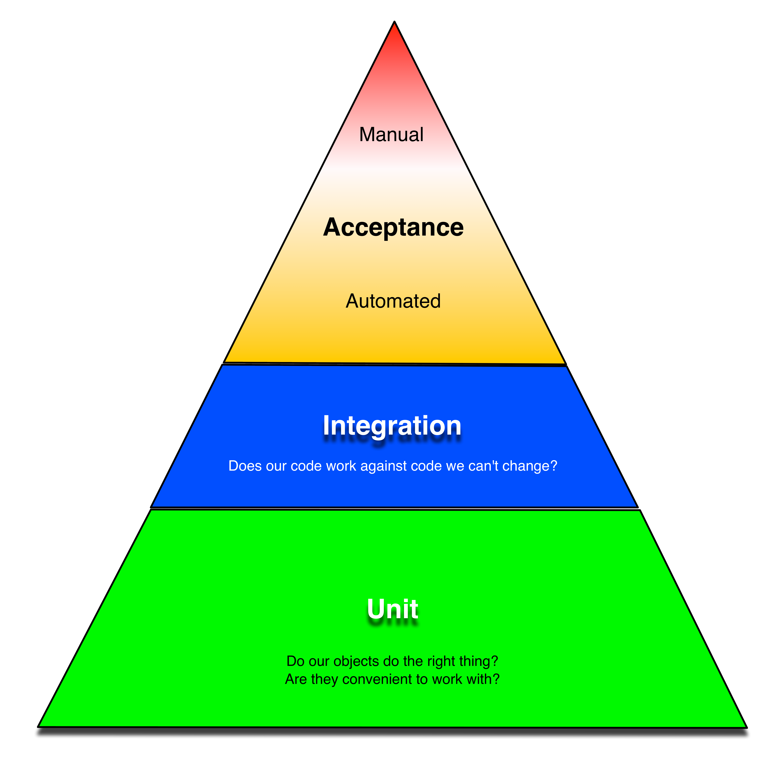
Easy to Test
Notes:
Add a new subsystem and start consuming events that are already in the system

Slide 14
Scales
Inventory
Inventory
Inventory
Orders
Invoicing
Inventory
Event Bus
Logging
Profiles
Reporting

Slide 15
The basic thesis of this article is that organizations which design systems (in the broad sense used here) are constrained to produce designs which are copies of the communication structures of these organizations.
--- Melvin Conway
Notes:
Do our software systems do not create friction in the organization

Slide 16
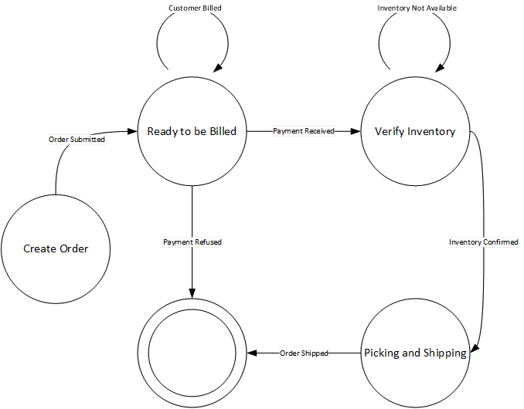
Easily Modeled as a finite state diagram

Slide 17
Other benefits
Ease of 3rd party integration
Existing systems can be ‘wrapped’
Can be deliberate about scaling
Fault tolerant
Event messages can be logged and ‘replayed’
Can test subsystems in isolation

Slide 18
A Retail System
Sales
Logger
Rabbit MQ Exchange
Invoicing
Shipping
Warehouse
Notes:
Add a new subsystem and start consuming events that are already in the system

Slide 19
A Retail System – Platform Agnostic
Sales
Logger
Rabbit MQ Exchange
Invoicing
Shipping
Warehouse
Notes:
Add a new subsystem and start consuming events that are already in the system

Slide 20
Order Accepted Event is generated
Sales
Logger
Rabbit MQ Exchange
Invoicing
Shipping
Warehouse
Notes:
Add a new subsystem and start consuming events that are already in the system

Slide 21
Customer Billed Event
Sales
Logger
Rabbit MQ Exchange
Invoicing
Shipping
Warehouse
Notes:
Add a new subsystem and start consuming events that are already in the system

Slide 22
Order Ready for Shipment Event
Sales
Logger
Rabbit MQ Exchange
Invoicing
Shipping
Warehouse
Notes:
Add a new subsystem and start consuming events that are already in the system

Slide 23
Order Shipped
Sales
Logger
Rabbit MQ Exchange
Invoicing
Shipping
Warehouse
Notes:
Add a new subsystem and start consuming events that are already in the system

Slide 24
Logger Consumes EVERY Event
Sales
Logger
Rabbit MQ Exchange
Invoicing
Shipping
Warehouse
Notes:
Can replay any chain of events for debugging purposes (and quality checks of production)

Slide 25
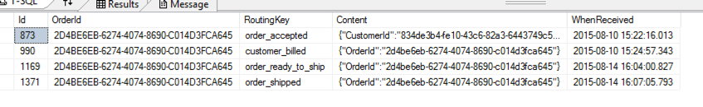
Logger Consumes EVERY Event

Slide 27
For Further Reading
THIS presentation (and code) on GitHub
https://github.com/shawnewallace/choreographed_process
Stephan Norberg EDA
http://www.infoq.com/presentations/Domain-Event-Driven-Architecture
“Programming Without a Call Stack”
http://www.enterpriseintegrationpatterns.com/docs/EDA.pdf
“Event-Driven Architecture Overview”
http://www.omg.org/soa/Uploaded%20Docs/EDA/bda2-2-06cc.pdf

Slide 29
Event-driven architecture is a versatile approach to designing complex software systems. These systems tend to be easier to model for an organization as EDA embraces Conway’s Law and can often be modeled as a finite state machine. Event-driven architecture is not a new concept, but as more organizations embrace micro services, this approach to system design has become appropriate in more situations. In this talk we’ll: introduce event-driven architecture, talk about key components, look at a sample implementation of a retail system.

